Slide 1



restaurants
View in Power BI
Last data refresh:
3/9/2022 8:10:09 PM UTC
Downloaded at:
3/9/2022 8:19:44 PM UTC

Slide 2
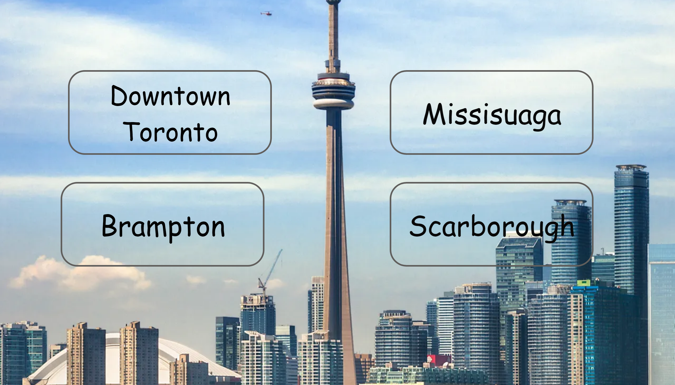
Home page
Notes:
Downtown Toronto
No alt text provided
Downtown Toronto
No alt text provided
Downtown Toronto
No alt text provided
Downtown Toronto
No alt text provided

Slide 3
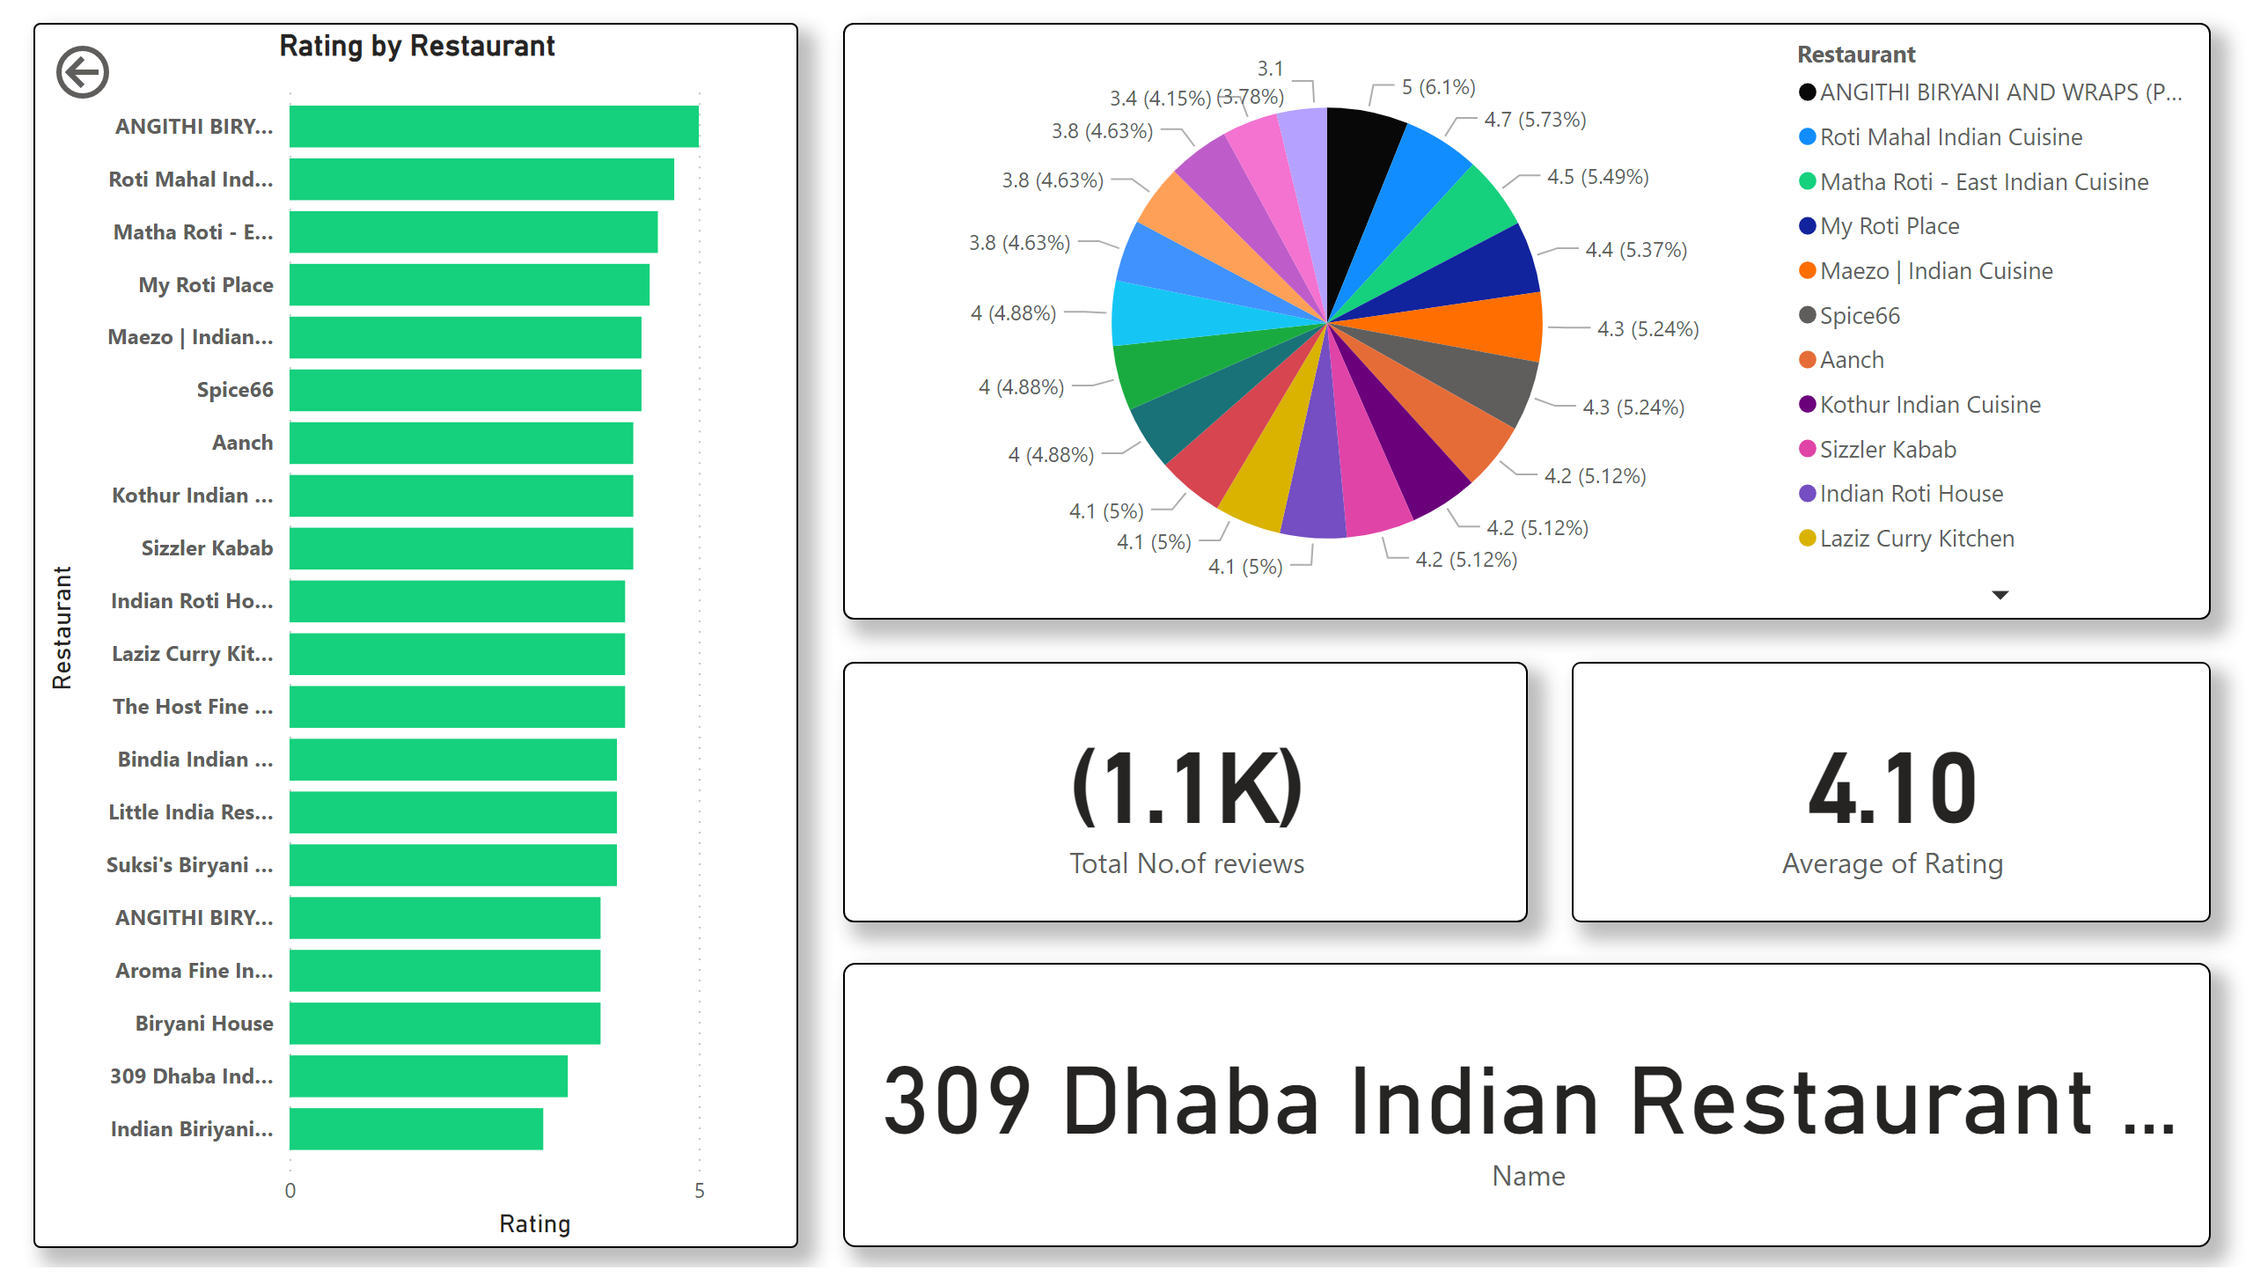
Dowtown Toronto
Notes:
pieChart
No alt text provided
card
No alt text provided
card
No alt text provided
card
No alt text provided
actionButton
No alt text provided
clusteredBarChart
No alt text provided

Slide 4
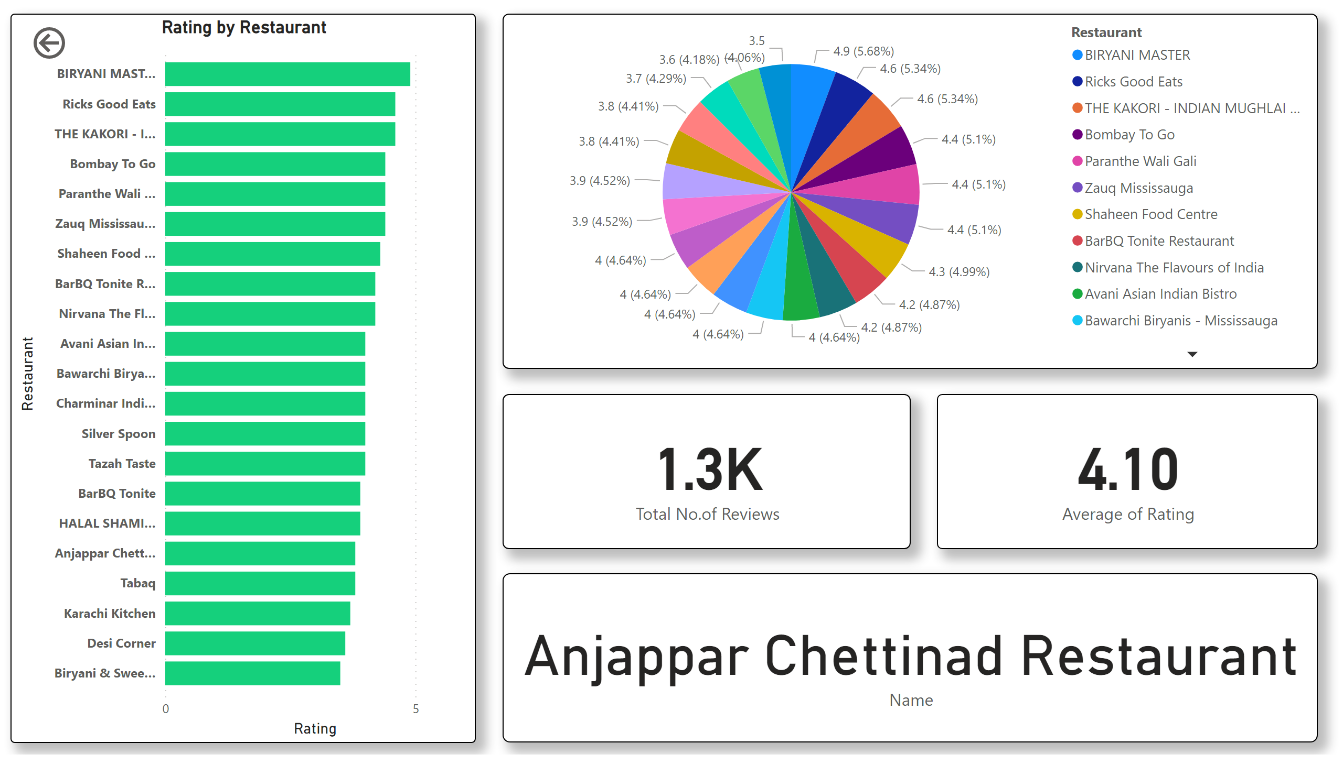
Missisuaga
Notes:
pieChart
No alt text provided
card
No alt text provided
card
No alt text provided
card
No alt text provided
actionButton
No alt text provided
clusteredBarChart
No alt text provided

Slide 5
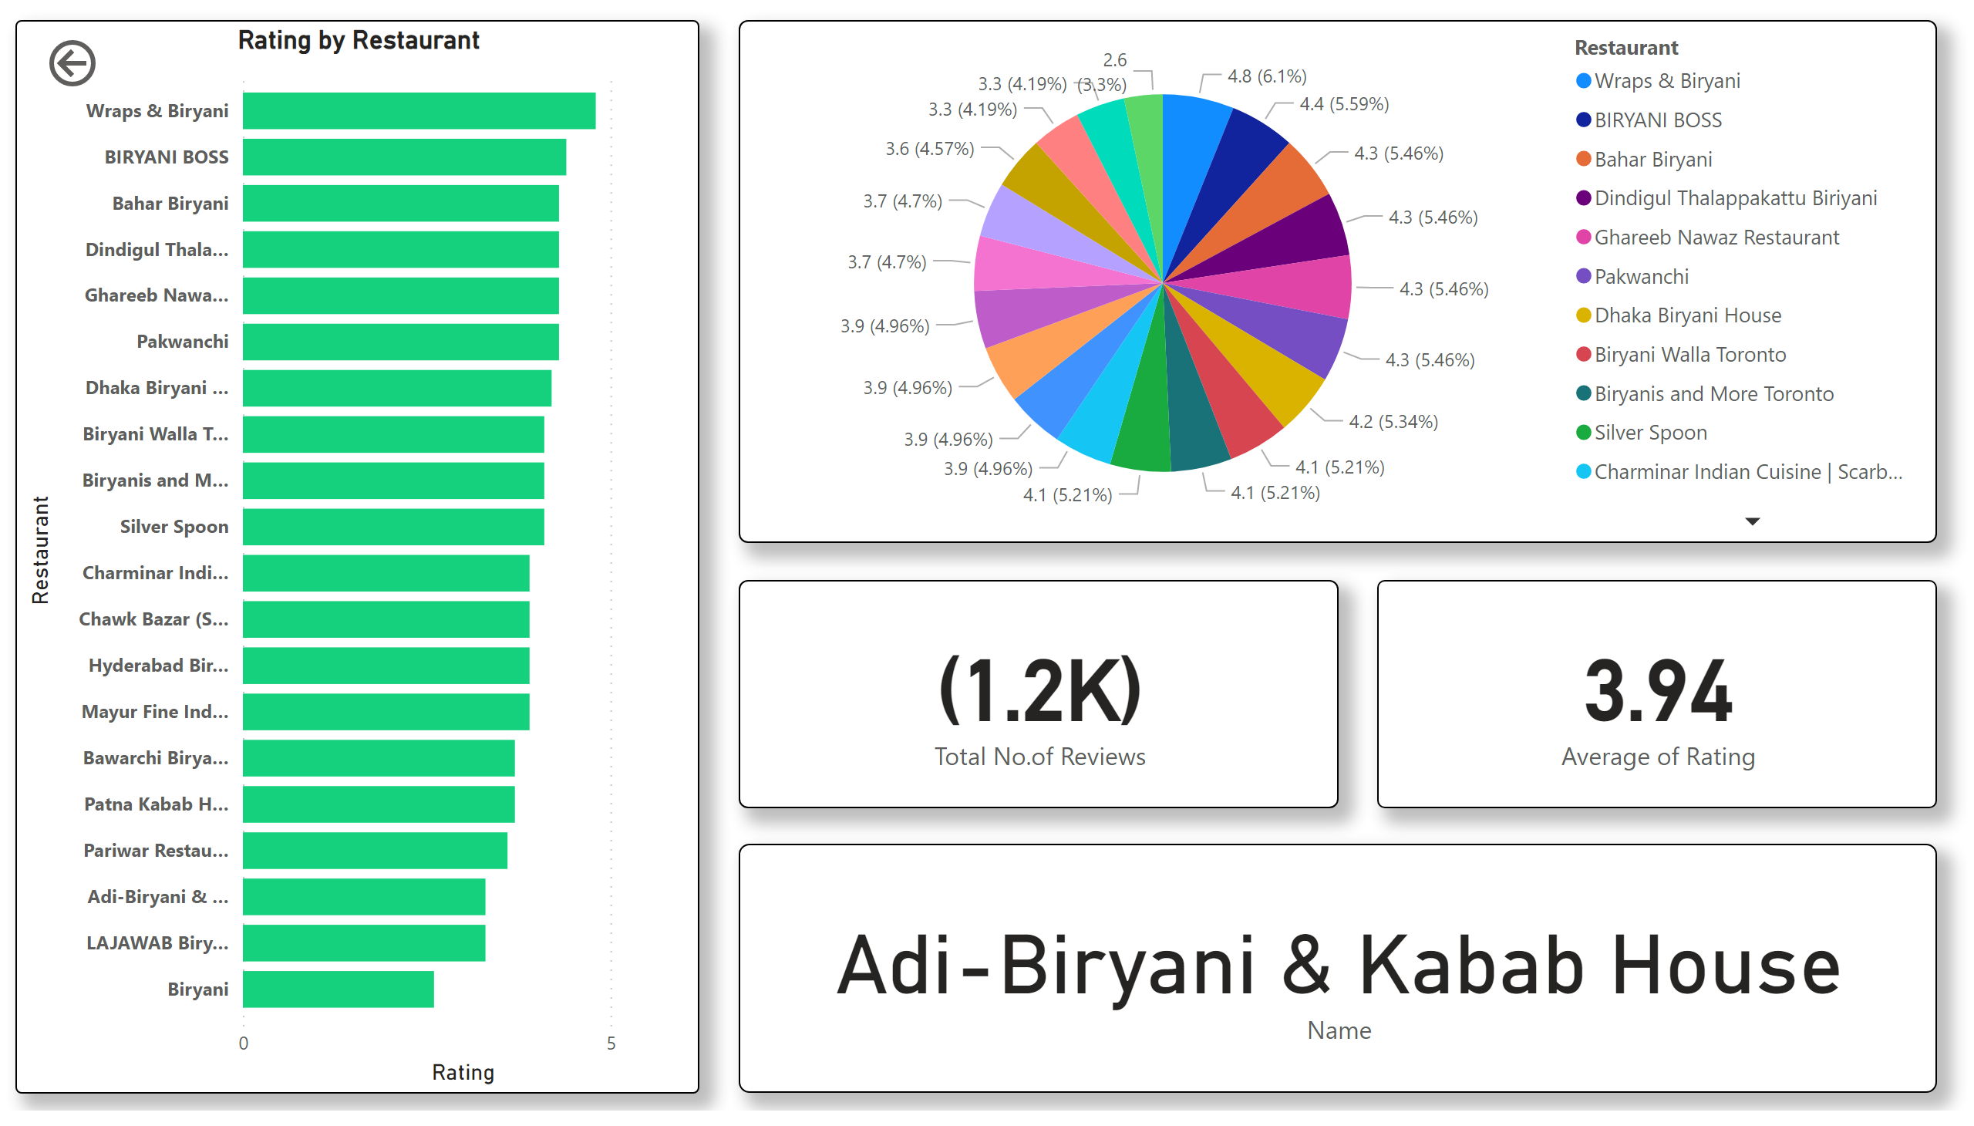
Scarborough
Notes:
pieChart
No alt text provided
card
No alt text provided
card
No alt text provided
card
No alt text provided
actionButton
No alt text provided
clusteredBarChart
No alt text provided

Slide 6
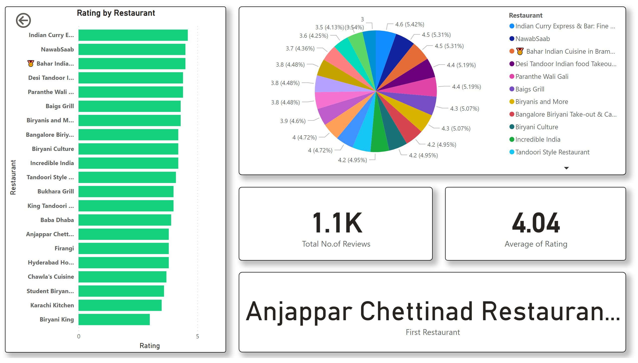
Brampton
Notes:
pieChart
No alt text provided
card
No alt text provided
card
No alt text provided
card
No alt text provided
actionButton
No alt text provided
clusteredBarChart
No alt text provided

